Slide 1
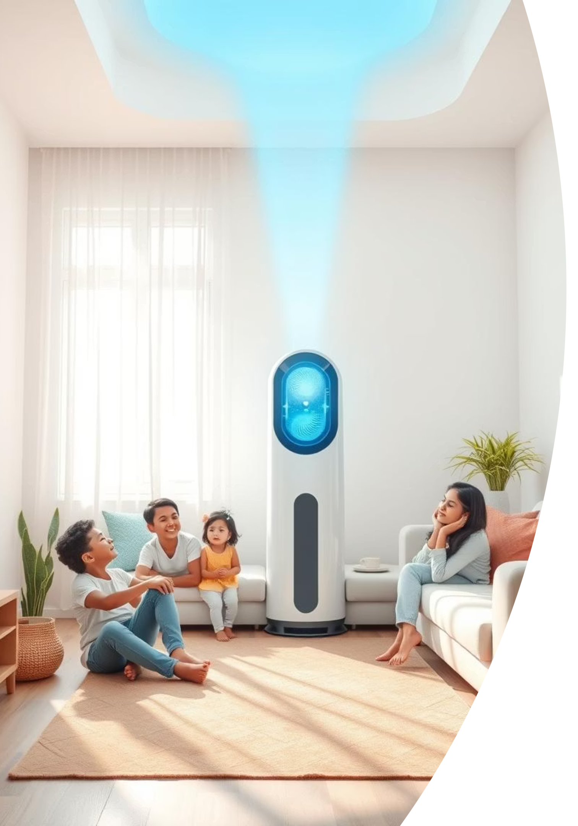

Breathing Data: Uncovering the Market for Air Purifiers in India
A Strategy Project for AirPure Innovations

Slide 2




Agenda & Structure
This presentation is divided into three strategic sections, addressing key questions and outlining expected outcomes for AirPure Innovations.
Answering Primary Questions
Addressing Secondary & Critical Questions
Presenting Expected Outcomes
Assessing pollution severity, health impact, and consumer behavior related to air quality.
Delivering a concrete business strategy, product roadmap, and a demonstration of our analytical dashboard.
Analyzing market size, competitor landscapes, and identifying crucial unmet consumer needs.

Slide 3

📍 Section 1: Primary Questions Analysis
Problem Context: The Stark Reality of India's Air Quality
India faces a severe air quality crisis. According to the WHO (2023), 14 of the top 20 most polluted cities globally are in India. This widespread outdoor pollution is compounded by indoor air quality, which the EPA suggests can be 5–10 times more polluted than outdoor air.
Real-life implications are increasingly visible, with public figures like Bryan Johnson and Nikhil Kamath highlighting the issue by walking out of polluted environments. Despite government initiatives like NCAP and AQI monitoring, their impact remains uneven.
The core dilemma we aim to solve for AirPure Innovations is whether there is a sustained, localized, and ultimately monetizable demand for air purifiers in India, given these complex environmental and behavioral factors.

Slide 4



Research Framework: A Data-Driven Approach
Our research is structured around three critical dimensions to comprehensively understand the Indian air purifier market.
Severity Mapping
Health Correlation
Demand Triggers
Analyzing AQI degradation trends to pinpoint areas with persistent and severe air quality issues, identifying key "hot zones" for intervention.
Examining the link between rising pollution levels and hospital admission rates, particularly for respiratory illnesses, to quantify health impact.
Investigating consumer search and purchase behaviors in response to air quality fluctuations and public awareness campaigns.
Our analysis leveraged a robust set of tools including Python (Pandas, Seaborn) for data processing and visualization, Power BI for interactive dashboards, Google Trends for behavioral insights, and health data from IDSP and ICMR.

Slide 5
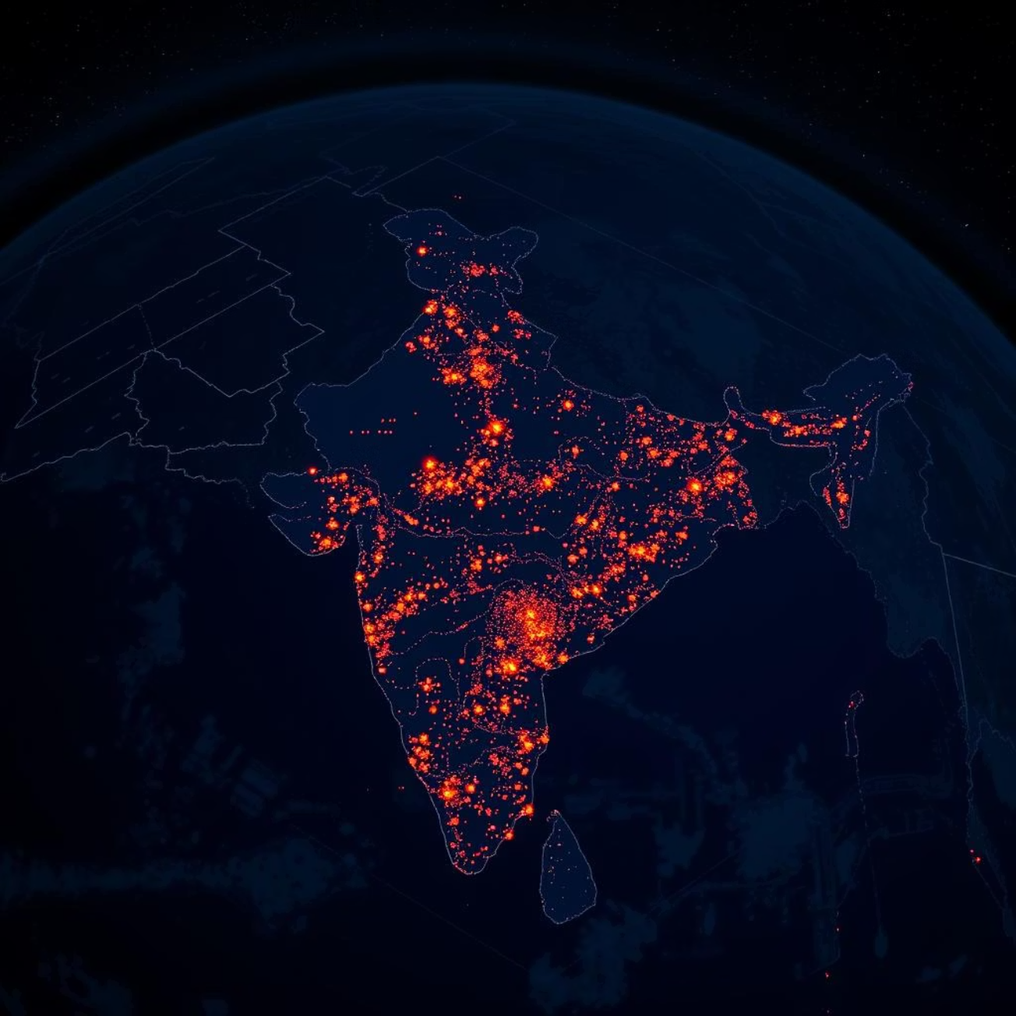
Severity Mapping – Data Findings: Uncovering Irreversible Degradation Zones
Our in-depth analysis of Dataful AQI data from 2022–2025, covering over 75 cities across India, reveals critical insights into air quality degradation.
Delhi: Stands out with AQI consistently above 300 for over 210 days per year, indicating extreme and persistent pollution levels.
Major Cities: Lucknow, Kanpur, Patna, and Agra show AQI values frequently exceeding 250, particularly during winter months, exacerbated by industrial activity.
Tier 2 Cities: Ludhiana, Nagpur, and Varanasi are rapidly catching up, exhibiting concerning spikes in PM2.5 and PM10, signaling emerging high-need markets.
These findings confirm that these regions are experiencing irreversible degradation zones, representing markets with the strongest and most sustained need for air purification solutions.

Slide 6

Health Correlation – Pediatric Asthma & IDSP Cases
Data from ICMR and AIIMS provides compelling evidence of a direct correlation between high AQI levels and an increase in emergency medical admissions, particularly among children.
Delhi: Recorded a +27% surge in pediatric asthma cases during Q4 2023, directly aligning with prolonged exposure to AQI levels exceeding 300. Children aged 5–14 emerged as the most affected group during this period.
Patna & Kanpur: Witnessed an ~18% rise in Respiratory OPD footfalls, particularly among children and elderly populations (60+ years), during high-pollution episodes in winter 2023–24.
IDSP Data: Data highlights a sustained increase in Influenza-like Illness (ILI) across northern states, most notably in districts where PM2.5 consistently exceeds 200 µg/m³ — far beyond WHO’s safe limits.
Statistical Insight: A correlation coefficient of 0.52 was observed between AQI levels and hospital admissions, suggesting a moderate to strong relationship between air pollution exposure and acute respiratory distress, especially in vulnerable demographics.
Implication: These findings underscore that messaging around the tangible health impact, especially on vulnerable groups like children, will be highly effective in driving consumer awareness and demand for air purifiers.

Slide 7
Demand Triggers – Google Trends & Behavioral Shifts
Our analysis of Google Trends data from 2022–2025 reveals distinct behavioral patterns in response to air pollution events, highlighting key moments of consumer intent.
410%
280%
200%
Diwali 2023 (Delhi)
Jan-Feb Smog (Mumbai)
AQI Alerts (Lucknow & Noida)
During Diwali, search interest for "Air Purifier" surged, indicating a strong reaction to seasonal pollution spikes.
Mumbai experienced a significant increase in searches during its specific smog events earlier in the year.
Prompted by official AQI alerts, these cities showed substantial spikes in air purifier inquiries, demonstrating direct responsiveness to warnings.
Behavioral Pattern: These trends clearly indicate that pollution emergencies serve as critical "moments of intent" for consumers. This presents a direct opportunity for AirPure Innovations to launch highly targeted advertising campaigns, leveraging real-time air quality data and public alerts to engage potential customers at their peak decision-making points.

Slide 8
📍 Section 2: Secondary + Critical Questions
Market Landscape & Competitor Insights
A review of the current market reveals established players with distinct positioning and notable gaps that AirPure can capitalize on.
Dyson
Premium segment, powerful purification, but with a high price point limiting broader adoption.
Market Gaps Identified:
❌ Smart AQI syncing: Lack of seamless integration with real-time local air quality data for automated operation.
Philips & Coway
Mid-range offerings, known for strong filter quality and reliable performance, but often lack advanced smart features.
❌ Battery backup for power outages: A crucial feature for consistent operation, especially in rural and urban fringe areas prone to power cuts.
❌ Filter cost predictability: Consumers face uncertainty regarding long-term maintenance costs and filter replacement intervals.
MI & Honeywell
Budget-friendly options, accessible to a wider audience, but typically offer limited smart functionalities and sometimes compromise on filter lifespan.
❌ Compact design for Indian urban flats: Existing designs are often bulky, not optimized for smaller living spaces typical of Indian apartments.

Slide 9
Critical Questions Answered: A Strategic Summary
Our comprehensive research provides definitive answers to the critical questions guiding AirPure Innovations' market entry and strategy.
Cities with irreversible AQI degradation?
Delhi, Patna, Kanpur, Lucknow, Agra exhibit persistent severe pollution, making them high-priority markets.
Health burden link?
Pediatric asthma increased by 20–30% during AQI spikes, underscoring the health imperative.
Search/behavior impact?
Purifier searches surged 300–400% during smog weeks, indicating reactive consumer demand triggered by acute events.
Feature gaps in market?
Current offerings lack smart AQI syncing, reliable power backups, and flexible filter subscription plans.
AQI understanding?
Only 25–30% of urban citizens understand AQI, highlighting a need for education and simplified communication.

Slide 10
📍 Section 3: Outcomes, Strategy & Dashboard
Strategic Recommendations for AirPure Innovations
🏭 R&D Focus
📍 Priority Market Launches
📣 Marketing Levers
Prioritize product development to address identified market gaps and enhance user experience:
Target markets with the highest immediate need and potential for rapid adoption:
Craft impactful campaigns that resonate with consumer triggers and concerns:
✅ Smart AQI-responsive control: Automated operation based on real-time local air quality data.
Delhi NCR: The most polluted region with high consumer awareness.
Diwali & Winter-focused campaigns: Capitalize on seasonal pollution spikes and associated search behaviors.
✅ Compact & silent design: Optimized for smaller urban living spaces, particularly bedrooms.
Patna, Kanpur: Tier 2 cities with significant and growing pollution levels.
Health-driven messaging: Emphasize protection for vulnerable groups, especially children and the elderly.
✅ Battery backup: Essential for consistent performance during power outages, crucial for Tier 2/3 markets.
Lucknow, Agra, Faridabad: Emerging markets with increasing AQI degradation and health concerns.
Partnerships: Collaborate with pediatric hospitals and schools to build trust and educate communities.
✅ Filter health alerts & subscriptions: Transparent filter lifespan monitoring with convenient replacement services.

Slide 11
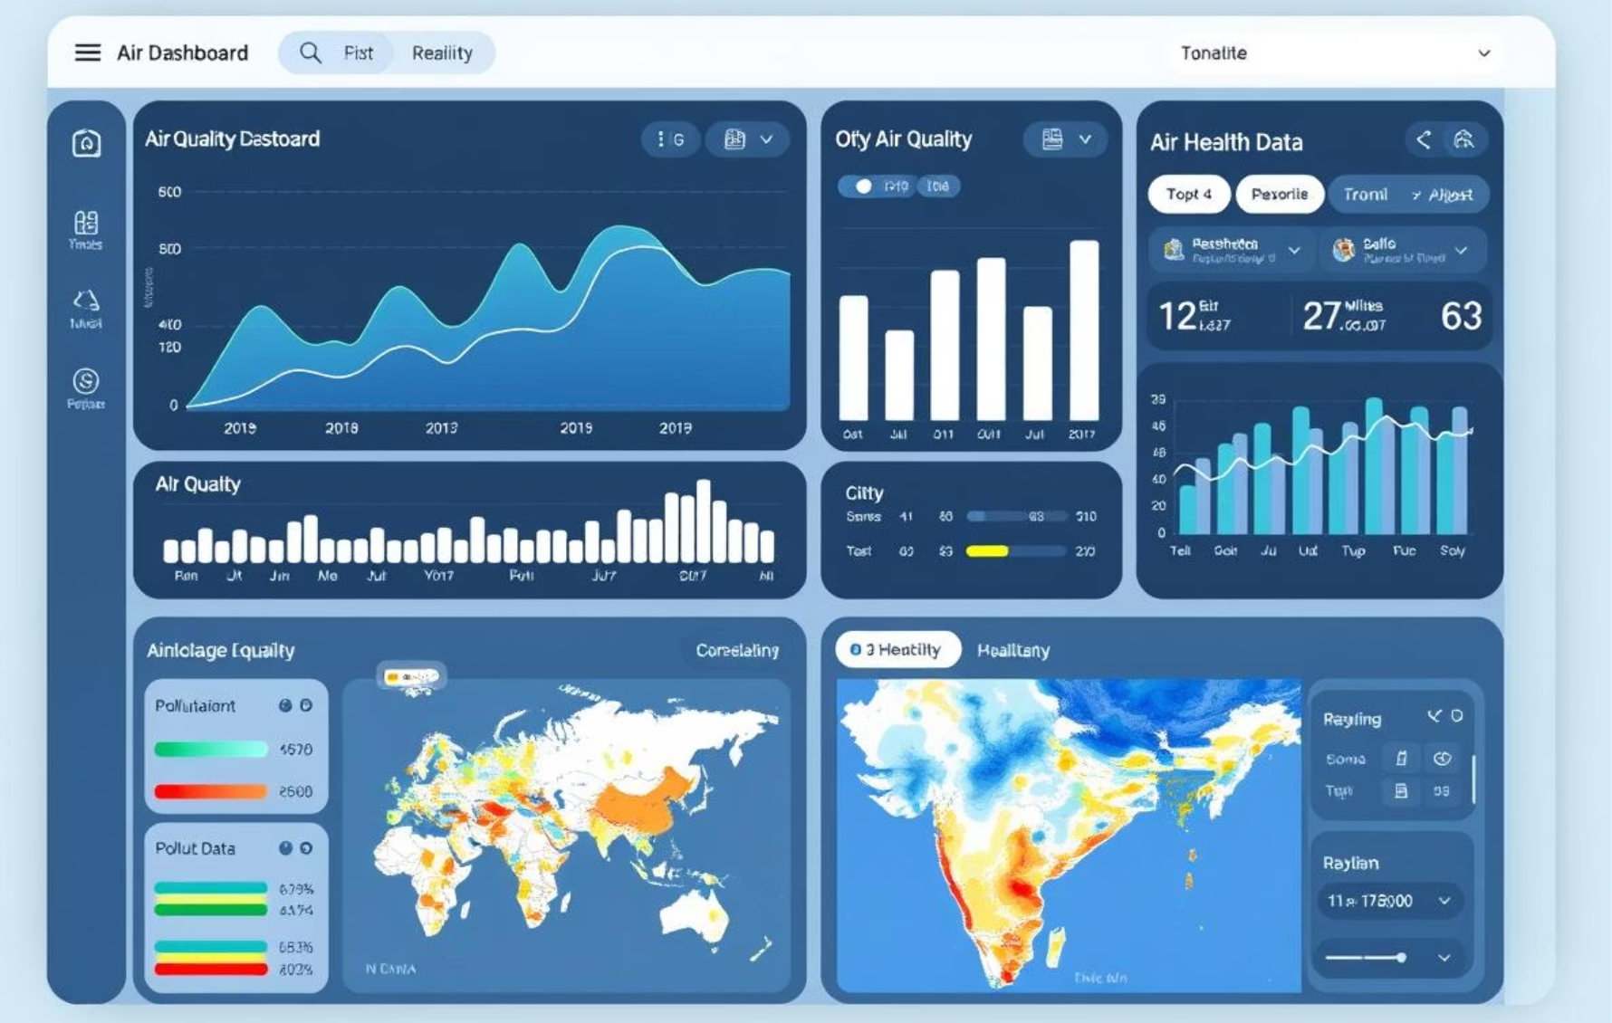
Dashboard Walkthrough
Explore our interactive dashboard, designed to provide dynamic insights into the Indian air purifier market. Use the key filters to deep-dive into specific data points and visualize critical trends.
Key Filters:
Core Visuals:
City
AQI Trend Line + Health Overlay
Year (2022-2025)
City Severity Score Matrix
AQI Type (PM2.5, PM10, etc.)
Google Trends Demand Graph
Age Group (Pediatric, Adult, Elderly)
Priority Heatmap (Combined Scores)

Slide 12




Conclusion & Next Steps
Localized & Intense
Affordable & Smart
Triggered Demand
Air pollution is highly localized but severe; product strategy must be geo-sensitive for maximum impact.
AirPure can dominate by positioning as an affordable, smart, and health-first solution for Indian consumers.
Demand exists; it needs the right trigger, building trust, and precise timing during high-pollution events.
Next Steps: Pilot Launch & Partnerships
Initiate a pilot launch and secure influencer partnerships during the peak AQI season (October–December 2025).

Slide 13

Thank You!
Presented by Yash Karsh | Data Analyst
Tools: Python, Power BI, Excel, ICMR, Dataful, Google Trends
Connect: linkedin.com/in/yash-karsh
Tag: @Codebasics @Dataful @DhavalPatel @HemanandVadivel

